Slide 1
Automatic Skin Labeling of Egocentric Images for Virtual Reality Applications
Heiko Raible
h_da Hochschule Darmstadt

Slide 2
Structure

Slide 3
Structure
Introduction

Slide 4
Structure
Introduction
Research

Slide 5
Structure
Introduction
Research
Implementation

Slide 6
Structure
Introduction
Research
Implementation
Evaluation

Slide 7
Structure
Introduction
Research
Implementation
Evaluation
Conclusion

Slide 8
Introduction

Slide 9
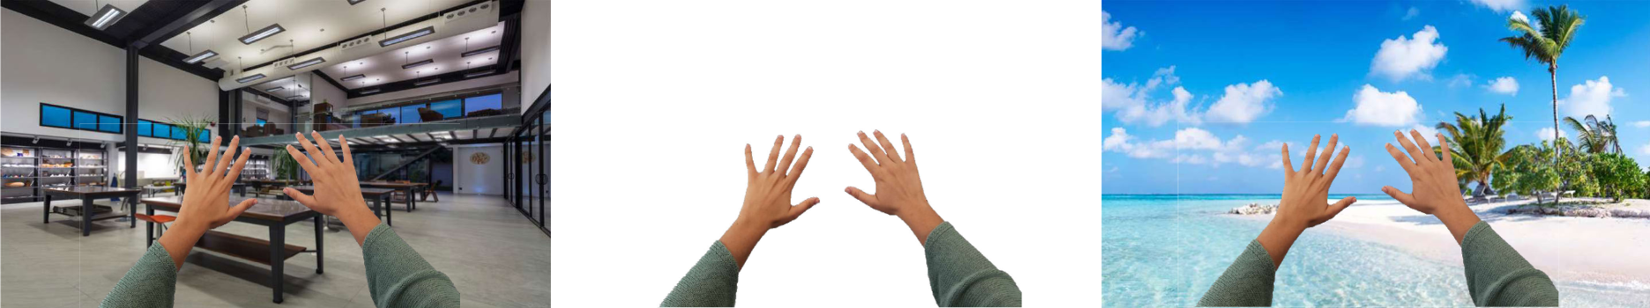
Previous Work

Slide 10
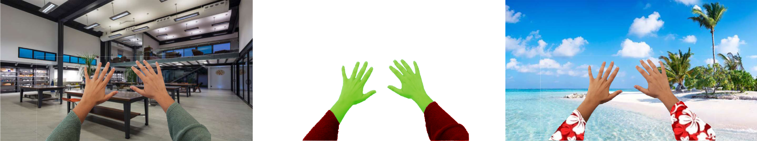
My Contribution

Slide 11
Research

Slide 12
GrabCut

Slide 13
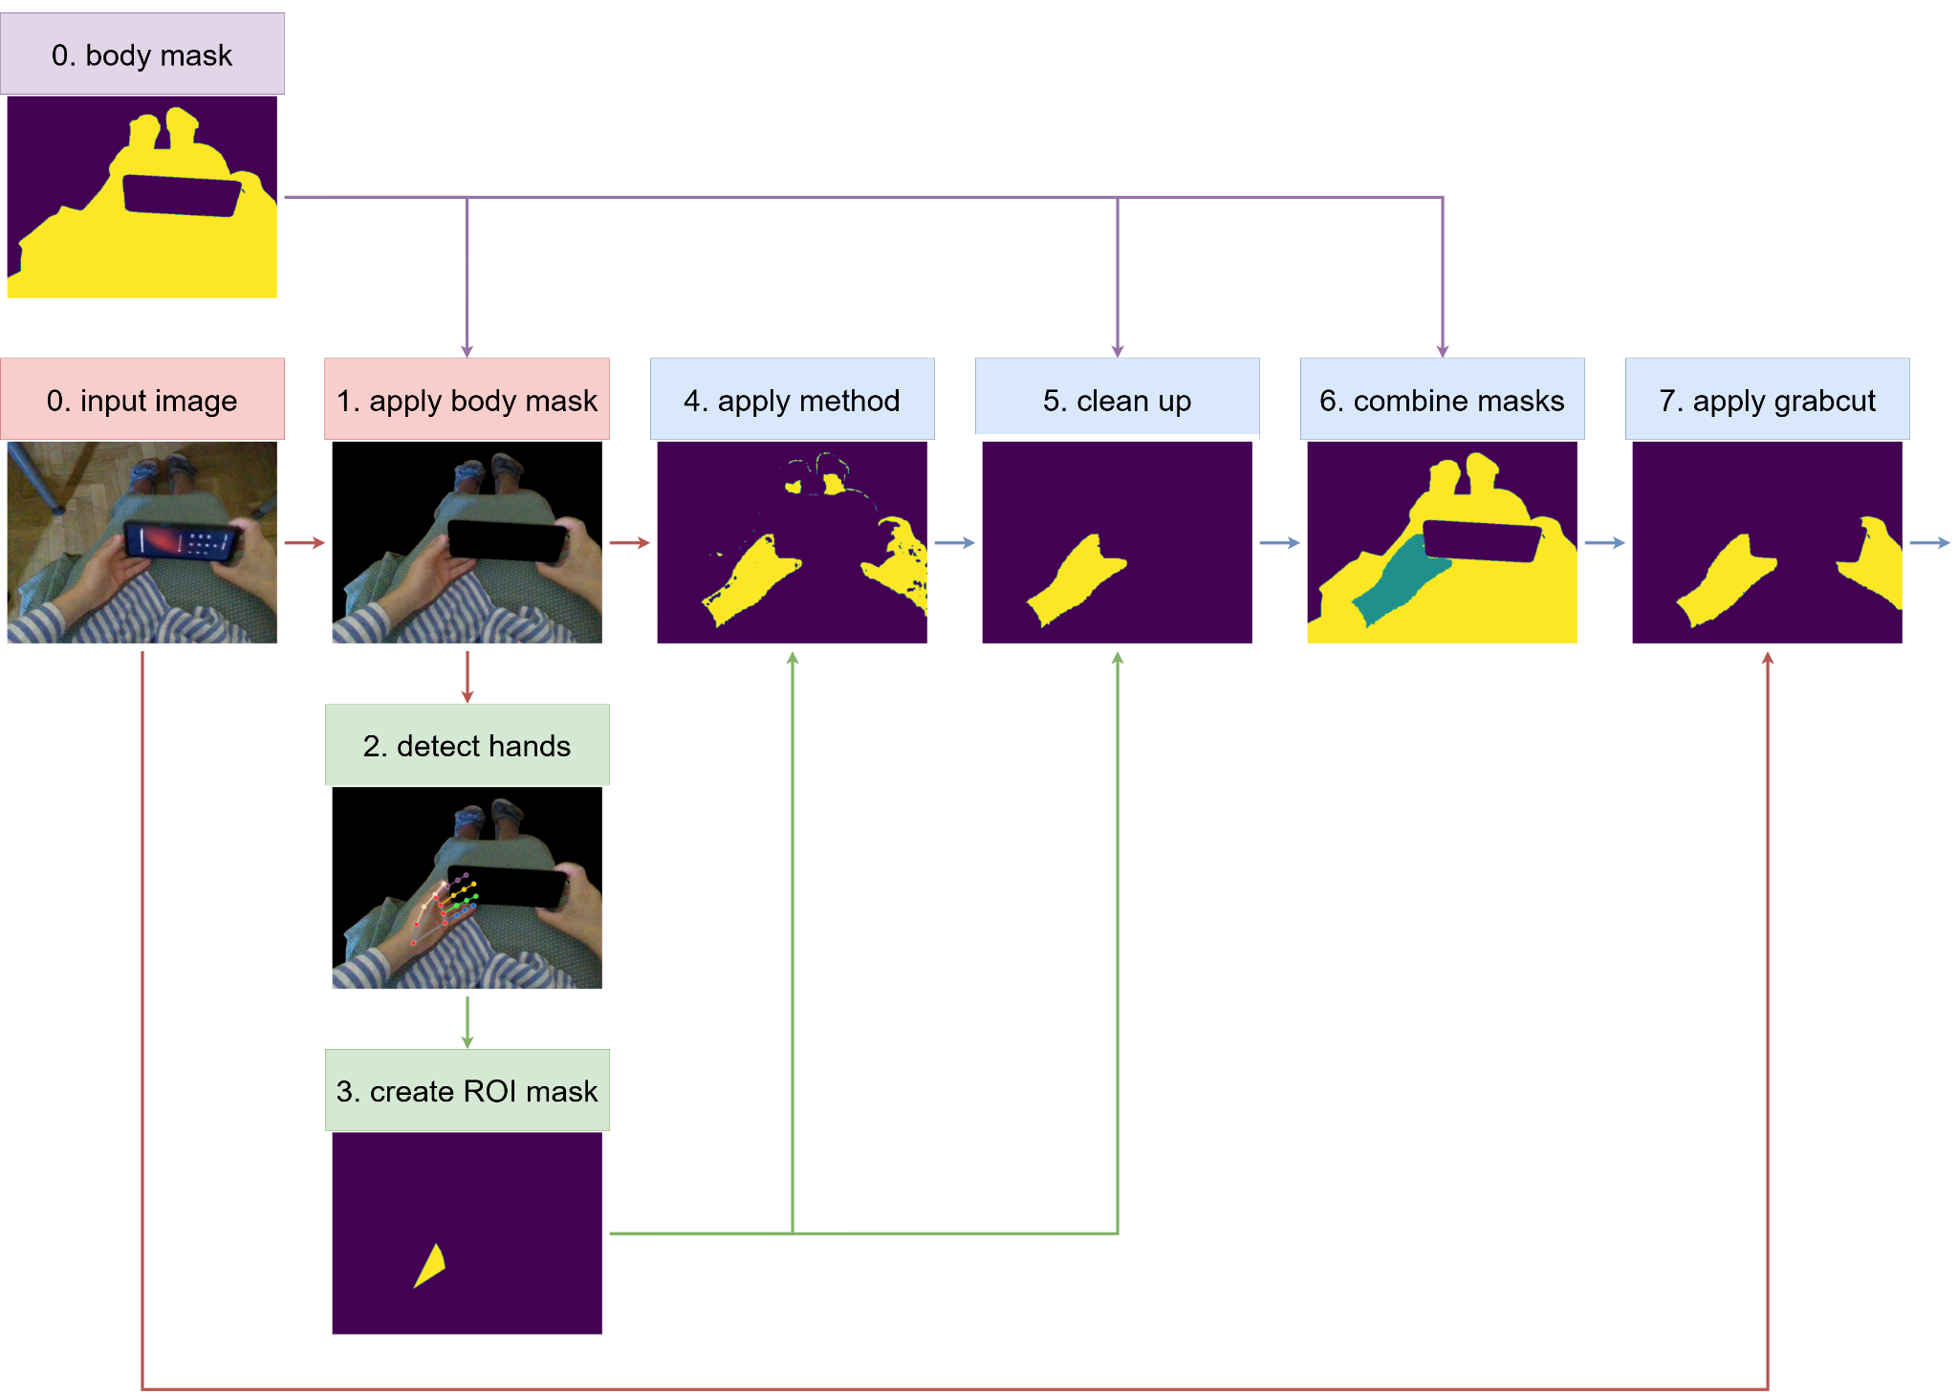
GrabCut
rough foreground and background mask

Slide 14
GrabCut
rough foreground and background mask
iteratively optimizes masks
Gaussian Mixture Models
spatial information
graph cuts

Slide 15
Color Spaces

Slide 16
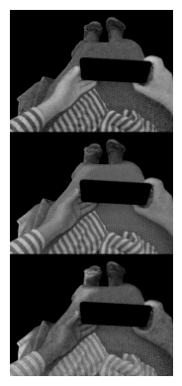
Color Spaces
RGB (red, green, blue)

Slide 17
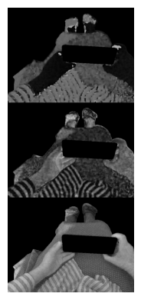
Color Spaces
RGB (red, green, blue)
HSV (hue, saturation, value)

Slide 18
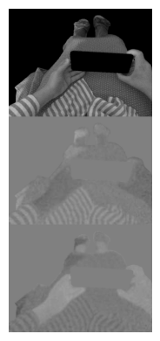
Color Spaces
RGB (red, green, blue)
HSV (hue, saturation, value)
YCrCb (luma, red-difference chroma, blue-difference chroma)

Slide 19
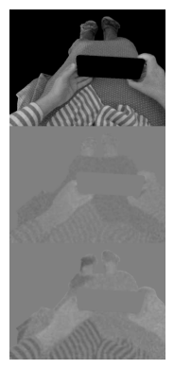
Color Spaces
RGB (red, green, blue)
HSV (hue, saturation, value)
YCrCb (luma, red-difference chroma, blue-difference chroma)
LAB (lightness, green-red, blue-yellow)

Slide 20
Otsu’s Method

Slide 21
Otsu’s Method
operates on greyscale

Slide 22
Otsu’s Method
operates on greyscale
calculates variance of intensity per threshold

Slide 23
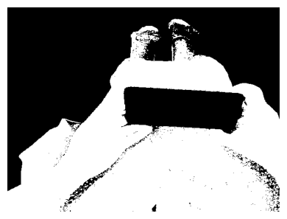
Otsu’s Method
operates on greyscale
calculates variance of intensity per threshold
maximizes between-class variance

Slide 24
MediaPipe Hands

Slide 25
MediaPipe Hands
lightweight Convolutional Neural Network (CNN)

Slide 26
MediaPipe Hands
lightweight Convolutional Neural Network (CNN)
based on MediaPipe Framework

Slide 27
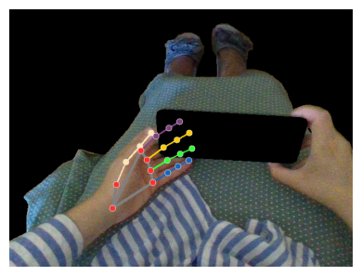
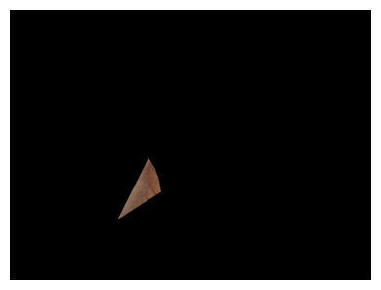
MediaPipe Hands
lightweight Convolutional Neural Network (CNN)
based on MediaPipe Framework
detects hands ⇒ skin patch Region of Interest (ROI)

Slide 28
Mask R-CNN

Slide 29
Mask R-CNN
ResNet (Residual Network)
addresses vanishing gradient problem (skip connections)

Slide 30
Mask R-CNN
ResNet (Residual Network)
addresses vanishing gradient problem (skip connections)
Faster R-CNN
region proposal network for object detection
region of interest pooling layer for classification and refinement

Slide 31
Mask R-CNN
ResNet (Residual Network)
addresses vanishing gradient problem (skip connections)
Faster R-CNN
region proposal network for object detection
region of interest pooling layer for classification and refinement
Mask R-CNN
mask prediction branch to generate segmentation mask per object

Slide 32
Implementation

Slide 33
Filtering Methods

Slide 34
Filtering Methods
color range inside ROI
RGB
HSV (no value)
YCrCb (no luminance)

Slide 35
Filtering Methods
color range inside ROI
RGB
HSV (no value)
YCrCb (no luminance)
Otsu’s method

Slide 36
Filtering Methods
color range inside ROI
RGB
HSV (no value)
YCrCb (no luminance)
Otsu’s method
histogram based inside ROI
HSV
LAB
YCrCb
HCrCb

Slide 37
End-to-end System

Slide 39


Slide 40


Slide 41


Slide 42


Slide 43


Slide 44


Slide 45


Slide 46
Mask R-CNN

Slide 47
Mask R-CNN
Training
pretrained on COCO
fine-tuned for 20 epochs

Slide 48
Evaluation

Slide 49
Datasets

Slide 50
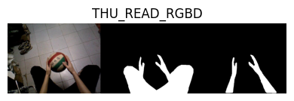
Datasets
THU-READ
158 images
multiple of same scene
many where skin = body ⇒ 35 body images

Slide 51
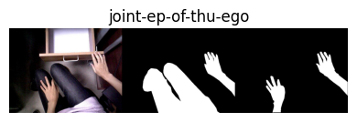
Datasets
THU-READ
158 images
multiple of same scene
many where skin = body ⇒ 35 body images
Egocentric Bodies
103 images
fewer of same scene
skin ≠ body

Slide 52
Datasets
THU-READ
Egocentric Bodies
Amazon Mechanical Turk

Slide 53
Datasets
THU-READ
Egocentric Bodies
Amazon Mechanical Turk
end-to-end system

Slide 54
Datasets
THU-READ
Egocentric Bodies
Amazon Mechanical Turk
end-to-end system
Mask R-CNN
data augmentation ⇒ 259 → 519 images
200 random test dataset 319 remaining training dataset

Slide 55
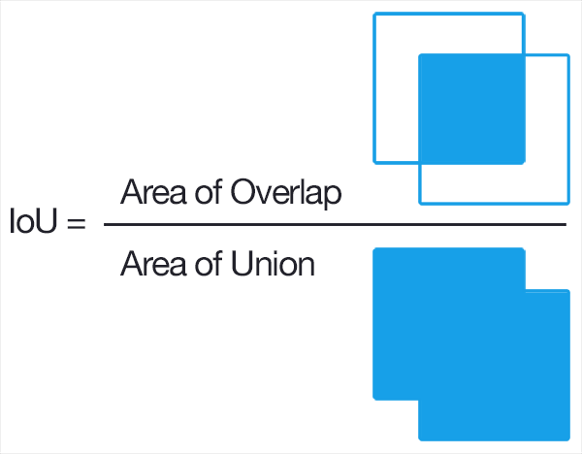
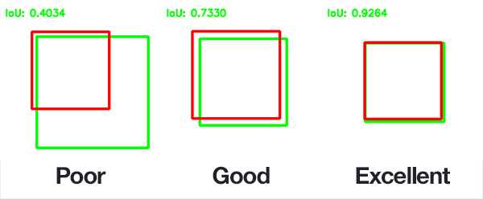
(mean) Intersection over Union (IoU)

Slide 56
Results

Slide 57
Results
end-to-end system

Slide 58
Results
end-to-end system
GrabCut iterations

Slide 59
Results
end-to-end system
GrabCut iterations
Mask R-CNN epochs

Slide 60
Results
end-to-end system
GrabCut iterations
Mask R-CNN epochs
illustrative examples

Slide 61
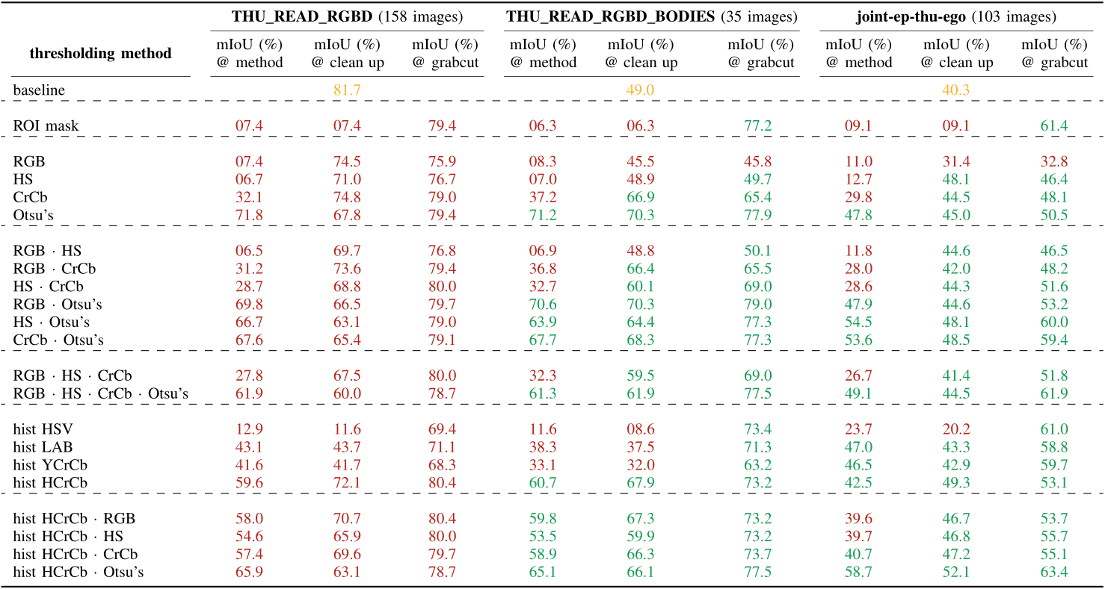

Slide 67
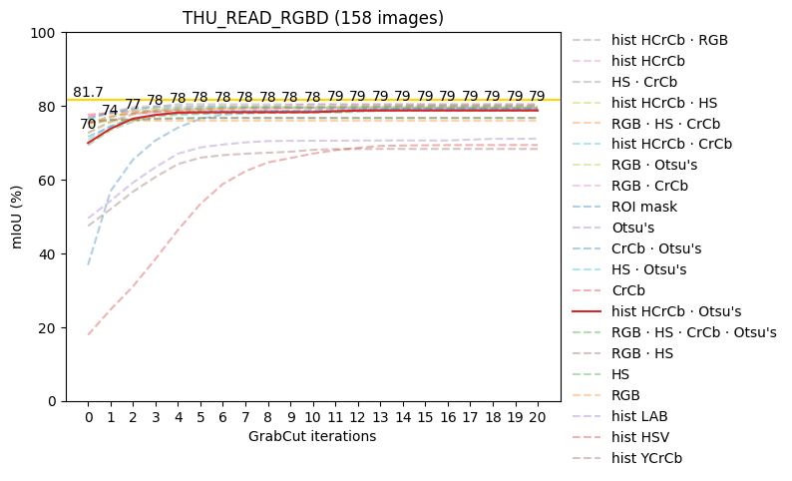
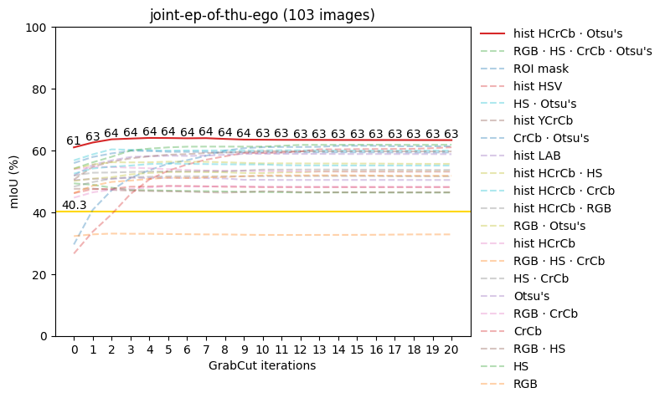
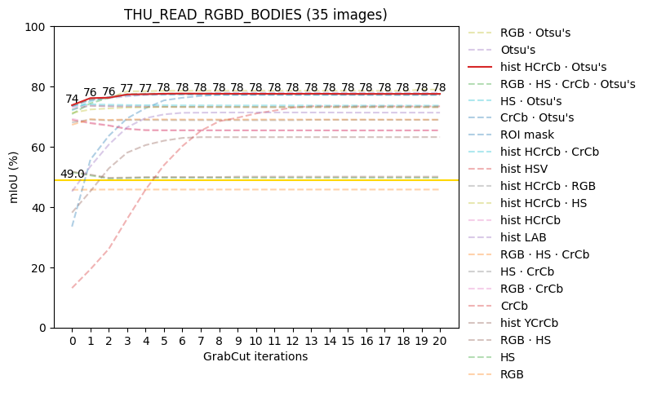
GrabCut iterations

Slide 68
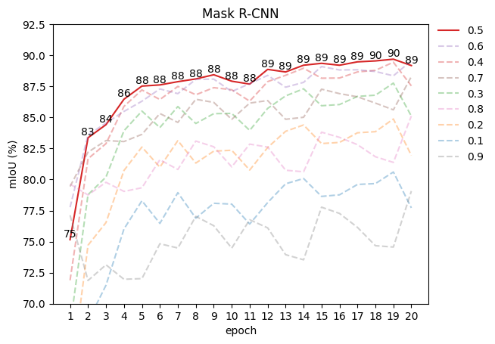
Mask R-CNN epochs

Slide 69
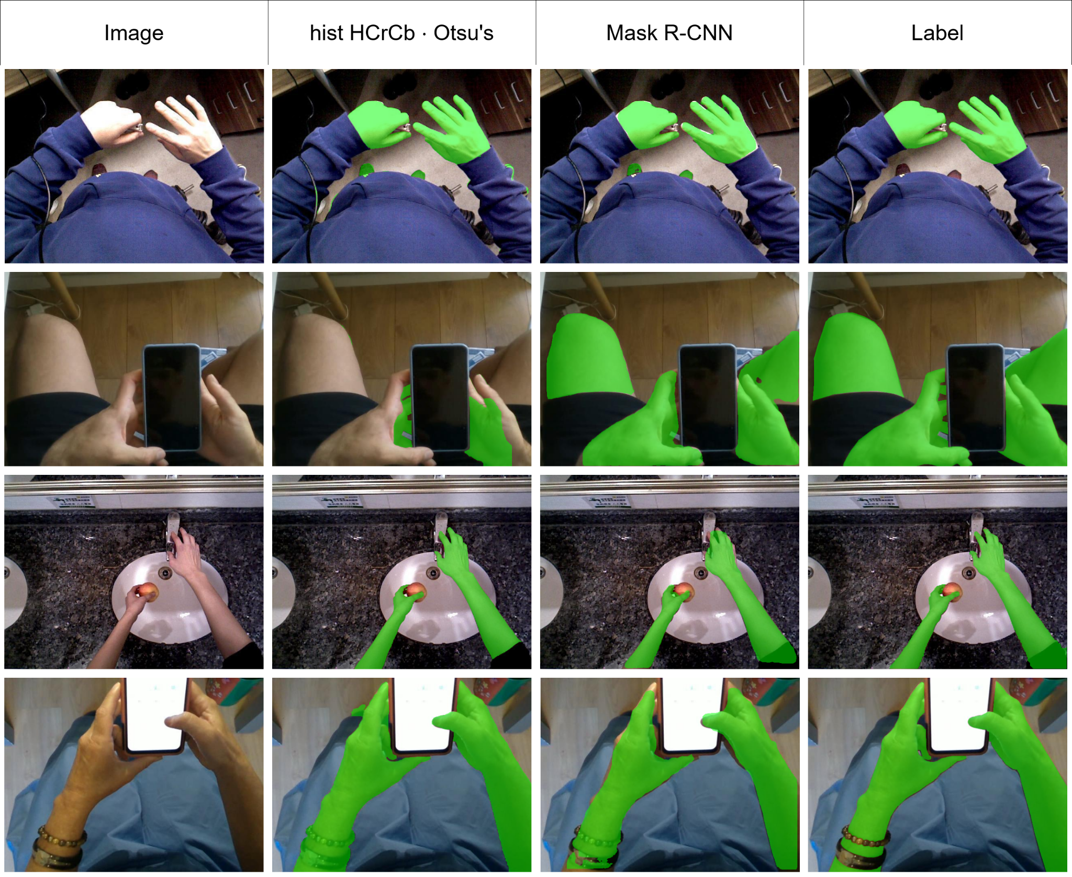

Slide 70
Conclusion

Slide 71
Limitations

Slide 72
Limitations
THU_READ_RGBD
80% skin = body

Slide 73
Limitations
THU_READ_RGBD
80% skin = body
in general
mistakes in labels
multiple images per scene

Slide 74
Limitations
THU_READ_RGBD
80% skin = body
in general
mistakes in labels
multiple images per scene
MediaPipe Hands

Slide 75
Limitations
THU_READ_RGBD
80% skin = body
in general
mistakes in labels
multiple images per scene
MediaPipe Hands
Mask R-CNN results put into question

Slide 76
Conclusion

Slide 77
Conclusion
skin segmentation for VR applications

Slide 78
Conclusion
skin segmentation for VR applications
color-based end-to-end system

Slide 79
Conclusion
skin segmentation for VR applications
color-based end-to-end system
deep learning model

Slide 80
Conclusion
skin segmentation for VR applications
color-based end-to-end system
deep learning model
complimentary approach

Slide 81
Future Work

Slide 82
Future Work
consider t-1 in video data

Slide 83
Future Work
consider t-1 in video data
less restrictive between mask and border

Slide 84
Future Work
consider t-1 in video data
less restrictive between mask and border
if skin doesn’t touch border, k-means (k=2)

Slide 85
Future Work
consider t-1 in video data
less restrictive between mask and border
if skin doesn’t touch border, k-means (k=2)
additional, different clean up step after GrabCut

Slide 86
Future Work
consider t-1 in video data
less restrictive between mask and border
if skin doesn’t touch border, k-means (k=2)
additional, different clean up step after GrabCut
investigate using semantic segmentation models

Slide 87
Future Work
consider t-1 in video data
less restrictive between mask and border
if skin doesn’t touch border, k-means (k=2)
additional, different clean up step after GrabCut
investigate using semantic segmentation models
more / higher quality datasets

Slide 88
Future Work
consider t-1 in video data
less restrictive between mask and border
if skin doesn’t touch border, k-means (k=2)
additional, different clean up step after GrabCut
investigate using semantic segmentation models
more / higher quality datasets
generate initial background mask through other means (no labels)

Slide 89
Thank you for listening!

